Slide 1
Lecture 06
Lexical Analysis – Transition Diagrams
CS351 - Lecture 06 - LA - TD

Slide 2
Transition Diagrams
A stylized flowchart
Transition diagrams consist of states connected by edges
Edges leaving a state s are labeled with input characters that may occur after reaching state s
Assumed to be deterministic
There is one start state and at least one accepting (final) state
Some states may have associated actions
At some final states, need to retract a character
CS351 - Lecture 06 - LA - TD

Slide 3
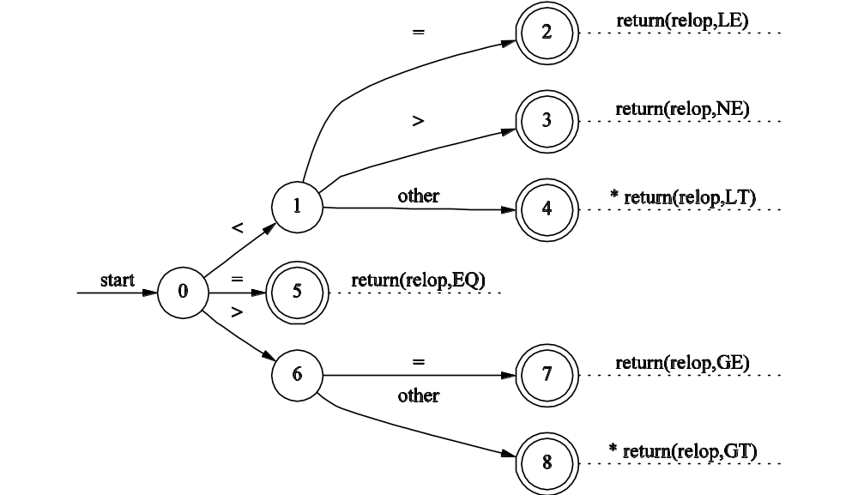
Transition Diagram for “relop”
CS351 - Lecture 06 - LA - TD

Slide 4
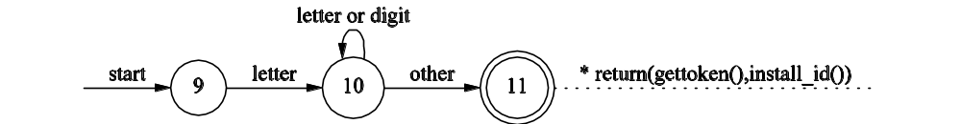
Identifiers and Keywords
Share a transition diagram
  After reaching accepting state, code determines if lexeme is keyword or identifier
  Easier than encoding exceptions in diagram
Simple technique is to appropriately initialize symbol table with keywords
CS351 - Lecture 06 - LA - TD

Slide 5
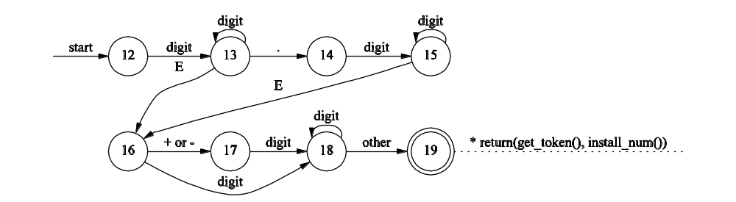
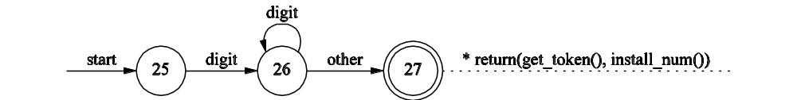
Numbers
CS351 - Lecture 06 - LA - TD

Slide 6
Order of Transition Diagrams
Transition diagrams tested in order
Diagrams with low numbered start states tried before diagrams with high numbered start states
Order influences efficiency of lexical analyzer
CS351 - Lecture 06 - LA - TD

Slide 7
Trying Transition Diagrams
int next_td(void) {
switch (start) {
case 0: start = 9; break;
case 9: start = 12; break;
case 12: start = 20; break;
case 20: start = 25; break;
case 25: recover(); break;
default: error("invalid start state");
}
/* Possibly additional actions here */
return start;
}
CS351 - Lecture 06 - LA - TD

Slide 8
Finding the Next Token
token nexttoken(void) {
while (1) {
switch (state) {
case 0:
c = nextchar();
if (c == ' ' || c=='\t' || c == '\n') {
state = 0;
lexeme_beginning++;
}
else if (c == '<') state = 1;
else if (c == '=') state = 5
else if (c == '>') state = 6
else state = next_td();
break;
… /* 27 other cases here */
CS351 - Lecture 06 - LA - TD

Slide 9
The End of a Token
token nexttoken(void) {
while (1) {
switch (state) {
… /* First 19 cases */
case 19:
retract();
install_num();
return(NUM);
break;
… /* Final 8 cases */
CS351 - Lecture 06 - LA - TD

Slide 10
Finite Automata
Generalized transition diagrams that act as “recognizer” for a language
Can be nondeterministic (NFA) or deterministic (DFA)
  NFAs can have ε-transitions, DFAs can not
  NFAs can have multiple edges with same symbol leaving a state, DFAs can not
  Both can recognize exactly what regular expressions can denote
CS351 - Lecture 06 - LA - TD

Slide 11
NFAs
A set of states S
A set of input symbols Σ (input alphabet)
A transition function move that maps state, symbol pairs to a set of states
A single start state s₀
A set of accepting (or final) states F
An NFA accepts a string s if and only if there exists a path from the start state to an accepting state such that the edge labels spell out s
CS351 - Lecture 06 - LA - TD

Slide 12
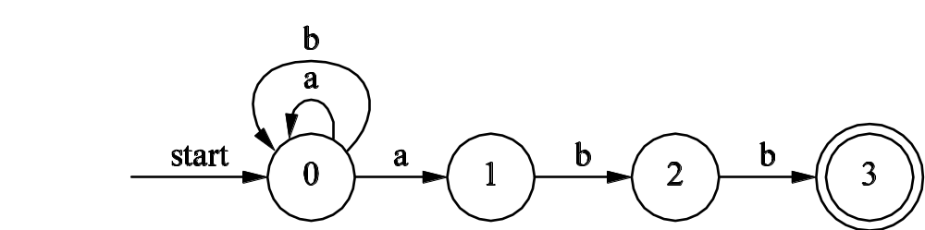
Transition Tables
State | Input Symbol
 | a | b
0 | {0,1} | {0}
1 | --- | {2}
2 | --- | {3}
CS351 - Lecture 06 - LA - TD

Slide 13
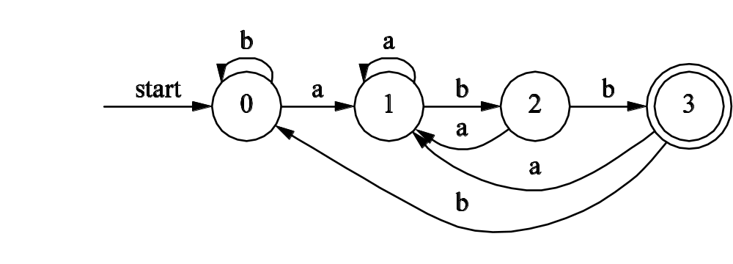
DFAs
No state has an ε-transition
For each state s and input symbol a, there as at most one edge labeled a leaving s
CS351 - Lecture 06 - LA - TD

Slide 14
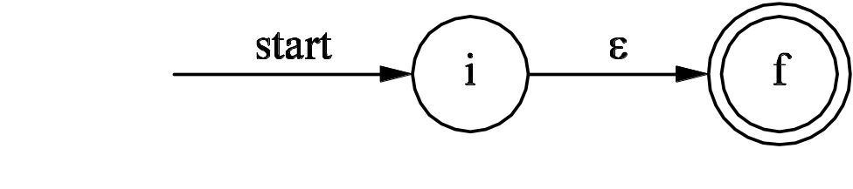
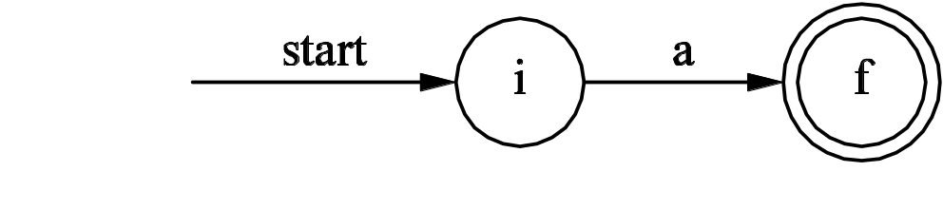
Thompson’s Construction
Method of converting a regular expression into an NFA
Start with two simple rules
  For ε, construct NFA:
  For each a in Σ, construct NFA:
Next will inductively apply a more complex rule until entire we obtain NFA for entire expression
CS351 - Lecture 06 - LA - TD

Slide 15
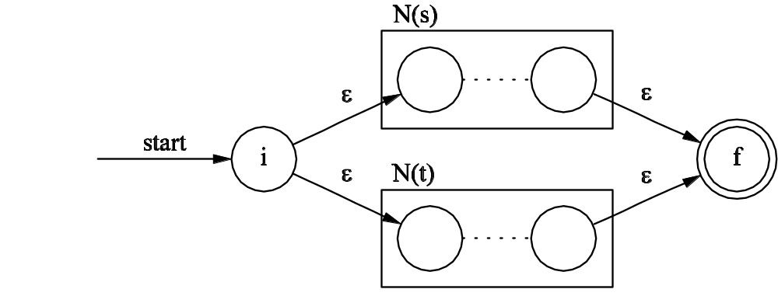
Complex Rule, Part 1
For the regular expression s|t, such that N(s) and N(t) are NFAs for s and t, construct the following NFA N(s|t):
CS351 - Lecture 06 - LA - TD

Slide 16
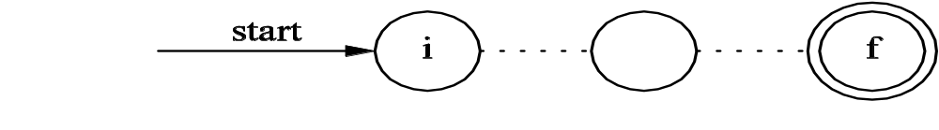
Complex Rule, Part 2
For the regular expression st, construct the composite NFA N(st):
N(S)
N(T)
CS351 - Lecture 06 - LA - TD

Slide 17
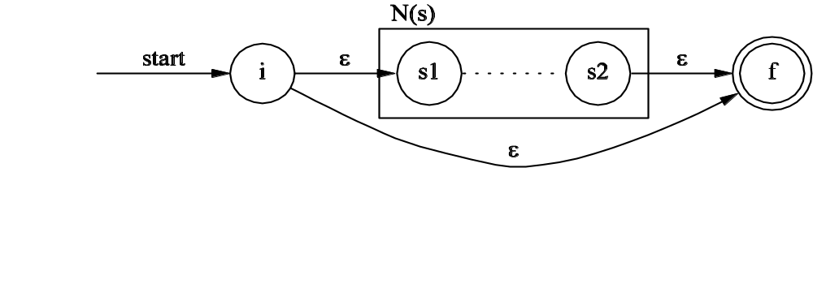
Complex Rule, Part 3
For the regular expression s*, construct the composite NFA N(s*):
ε
CS351 - Lecture 06 - LA - TD

Slide 18
Complex Rule, Part 4
For the parenthesized regular expression (s), use N(s) itself as the NFA
CS351 - Lecture 06 - LA - TD

Slide 19
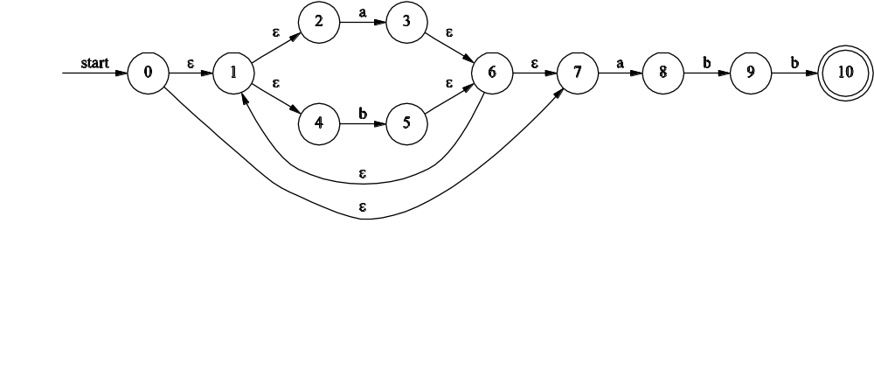
Example: r = (a|b)*abb
CS351 - Lecture 06 - LA - TD

Slide 20
Functions ε-closure and move
ε-closure(s) is the set of NFA states reachable from NFA state s on ε-transitions alone
ε-closure(T) is the set of NFA states reachable from any NFA state s in T on ε-transitions alone
move(T,a) is the set of NFA states to which there is a transition on input a from any NFA state s in T
CS351 - Lecture 06 - LA - TD

Slide 21
Computing ε-closure
push all states in T onto stack
initialize ε-closure(T) to T
while stack is not empty
pop t from top of stack
for each state u with an ε-transition from t
if u is not in ε-closure(T) then
add u to ε-closure(T)
push u onto stack
CS351 - Lecture 06 - LA - TD

Slide 22
Subset Construction (NFA to DFA)
initialize Dstates to unmarked ε-closure(s₀)
while there is an unmarked state T in Dstates
mark T
for each input symbol a
U := ε-closure(move(T,a))
if U is not in Dstates
add U as unmarked state to Dstates
Dtran[T,a] := U
CS351 - Lecture 06 - LA - TD

Slide 23
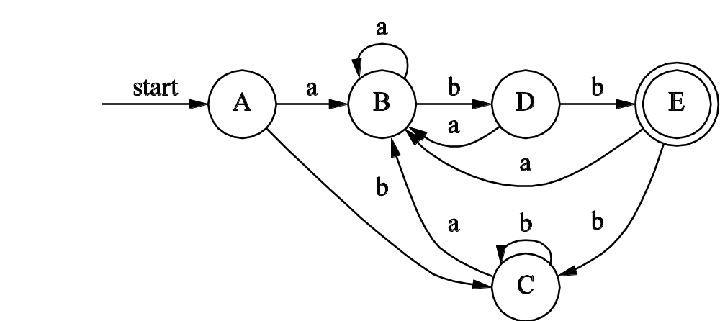
Constructed DFA
CS351 - Lecture 06 - LA - TD

Slide 24
Simulating a DFA
s := s₀
c := nextchar
while c != eof do
s := move(s, c)
c := nextchar
end
if s is in F then
return “yes”
else
return “no”
CS351 - Lecture 06 - LA - TD

Slide 25
Simulating an NFA
S := ε-closure({s₀})
a := nextchar
while a != eof do
S := ε-closure(move(S,a))
a := nextchar
if S ∩ F != Ø
return “yes”
else
return “no”
CS351 - Lecture 06 - LA - TD

Slide 26
Space/Time Tradeoff (Worst Case)
 | Space | Time
NFA | O(|r|) | O(|r|*|x|)
DFA | O(2^{|r|}) | O(|x|)
CS351 - Lecture 06 - LA - TD

Slide 27
Simulating a Regular Expression
First use Thompson’s Construction to convert RE to NFA
Then there are two choices:
  Use subset construction to convert NFA to DFA, then simulate the DFA
  Simulate the NFA directly
CS351 - Lecture 06 - LA - TD

Slide 28
Lex will do it!
CS351 - Lecture 06 - LA - TD

